Slide 1
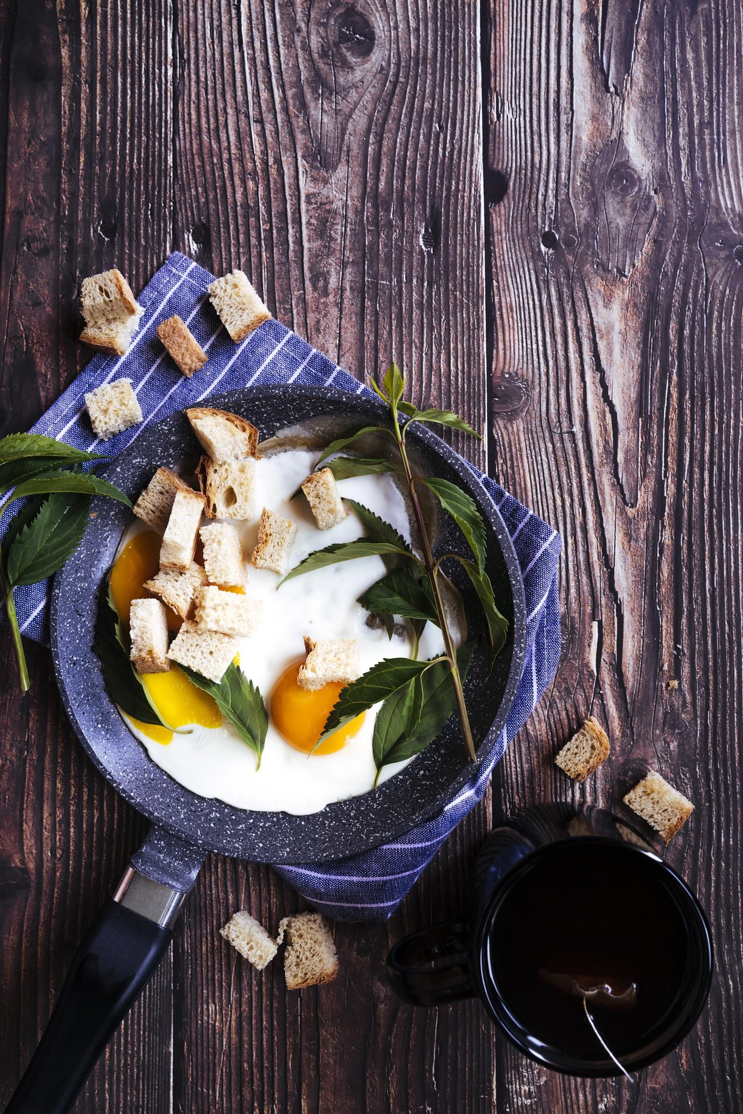
Restaurant Business Analysis and Optimization Using Yelp Dataset
Vaibhav Saraf Saurabh Parkar
Sanjan Vijayakumar Kunjan Khatri

Slide 2
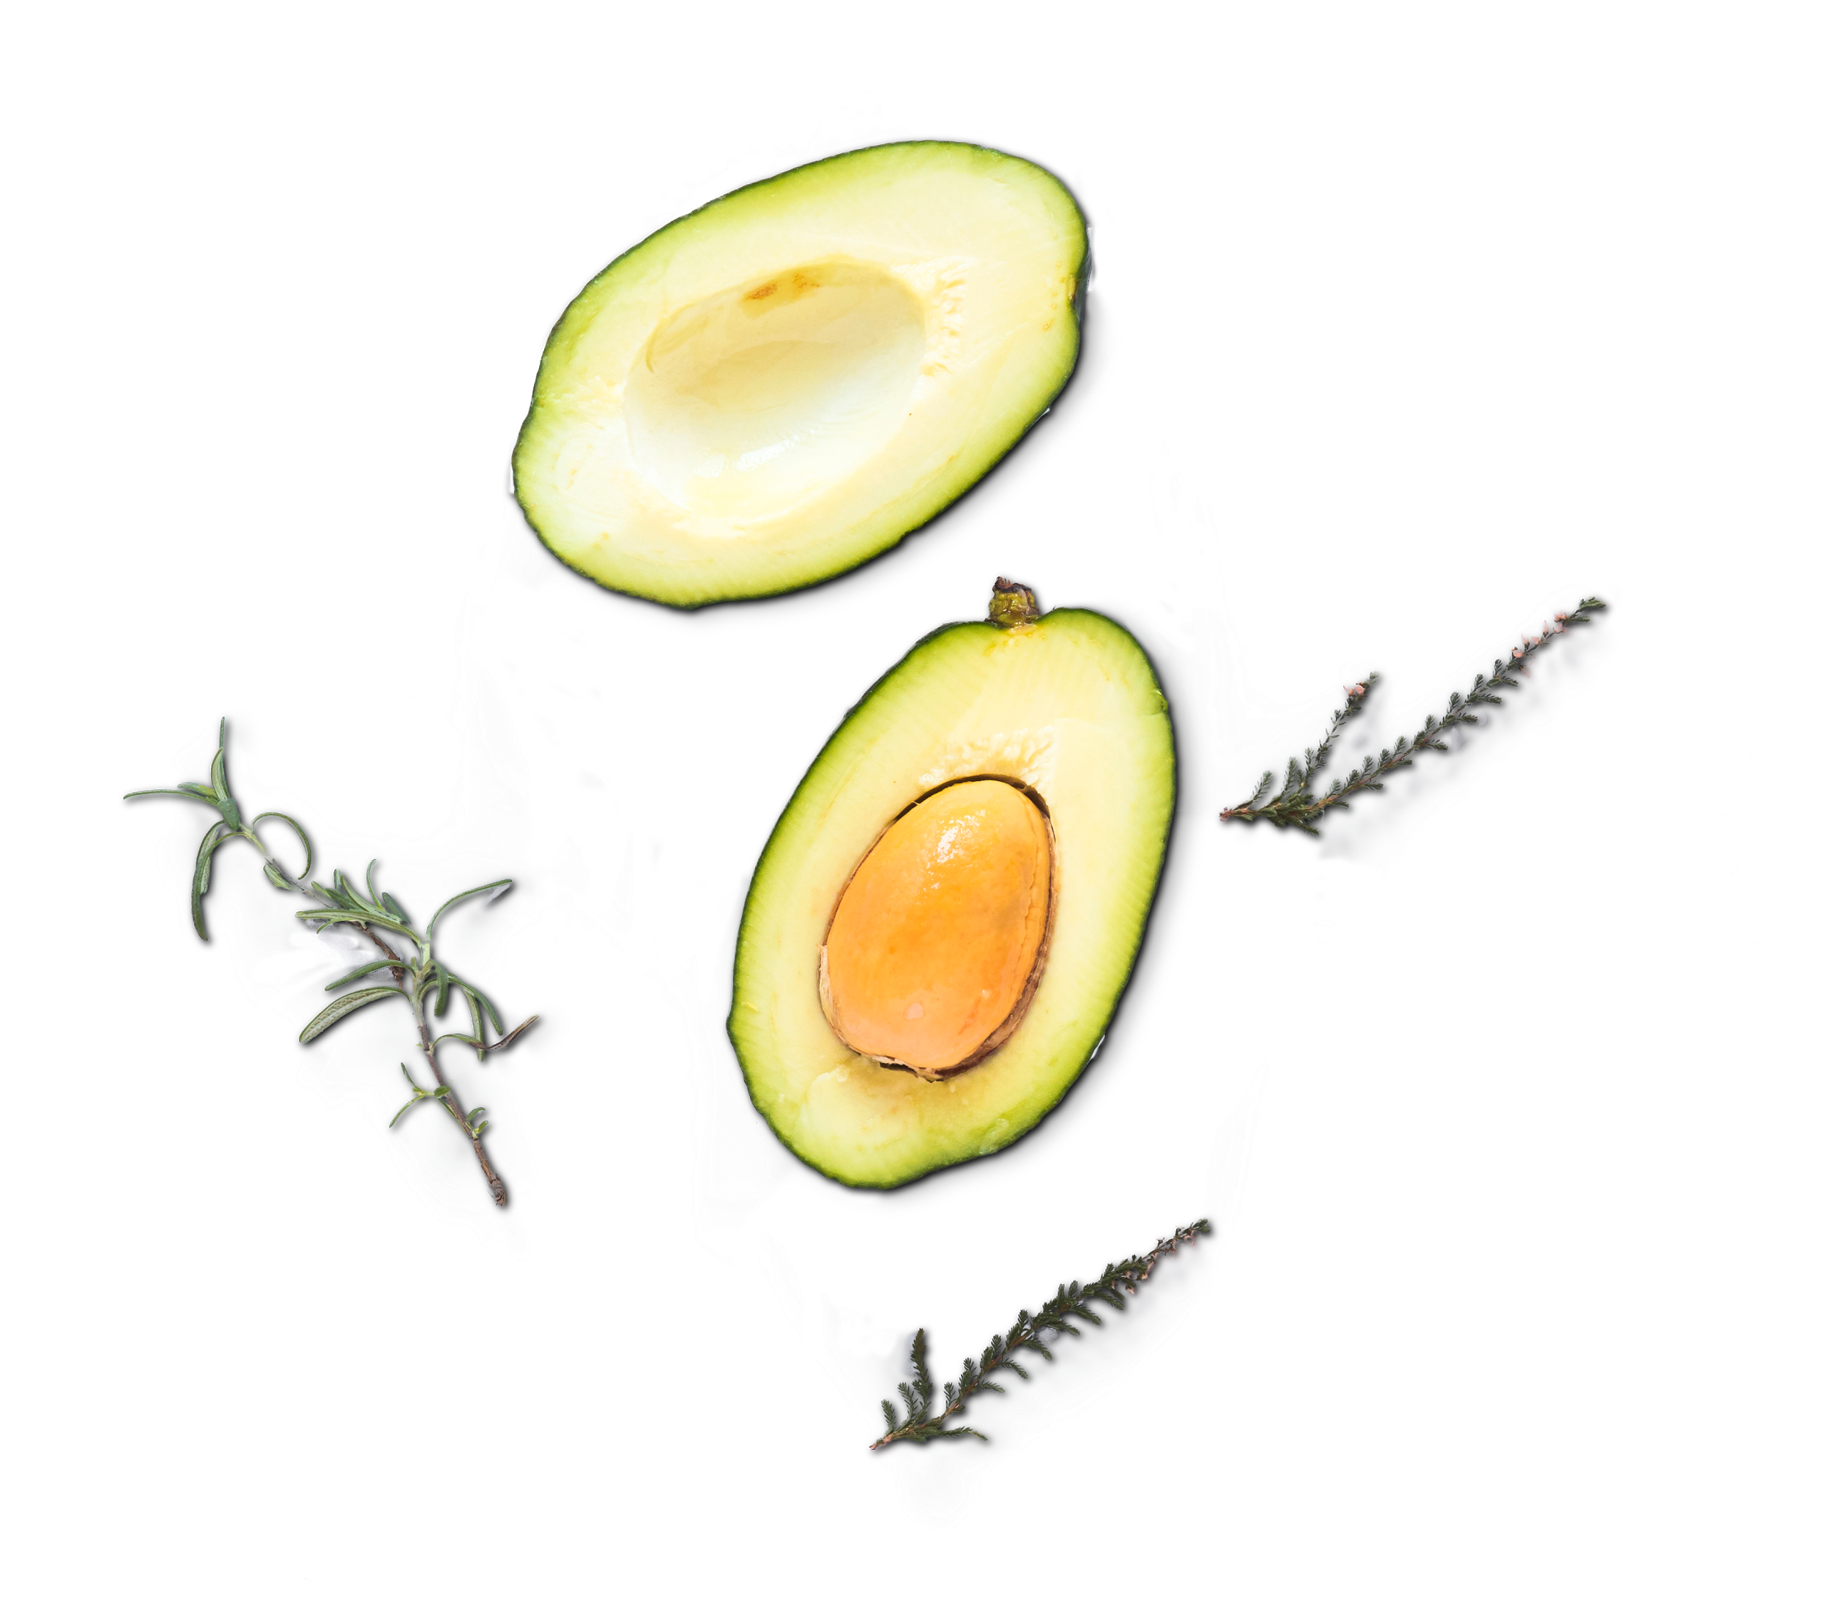
Goals
GOAL 1
GOAL 3
GOAL 2
Restaurant Segmentation
using clustering
Restaurant Recommendation
Topic Modelling for
Review Analysis

Slide 3
Description
Preprocessing
Yelp Dataset
Filtering
Reviews
JSON
Business
Text
Subset of businesses, reviews, and user data
Restaurant categories
5.8 Million user reviews
Merged business file with review file
180K businesses across USA
Stemming and Lemmatization of reviews

Slide 4
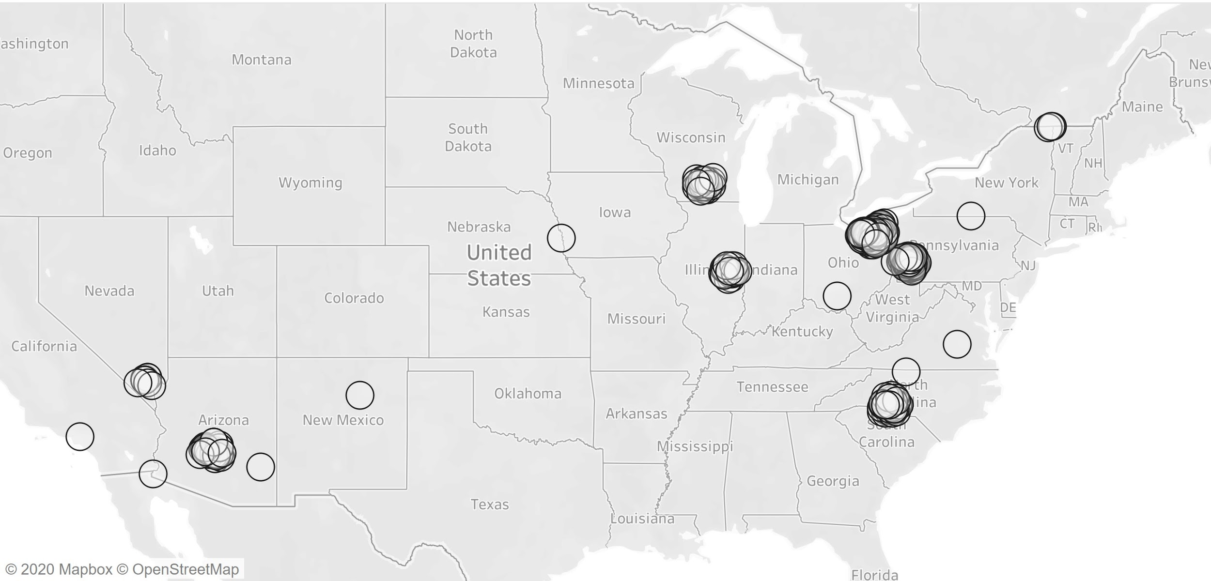
EDA

Slide 5
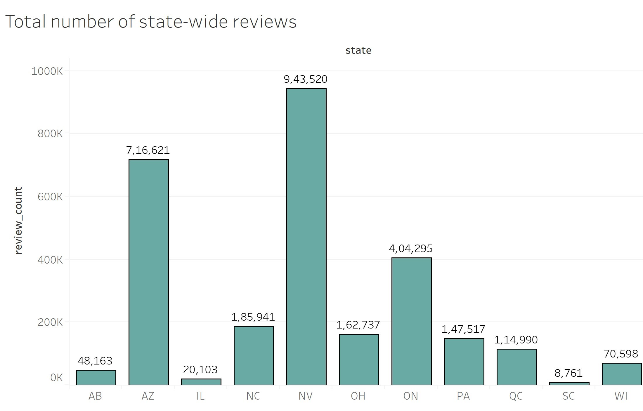
EDA

Slide 6
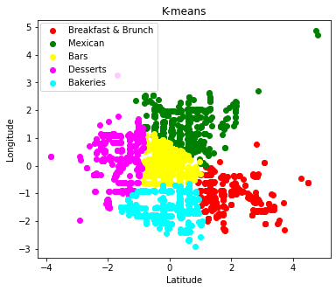
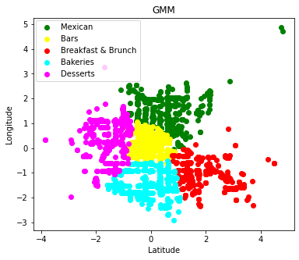
Top Categories
“Culinary districts" of Las Vegas
"categories" to cluster for similarity
"longitude" and "latitude" to cluster closeness
“K-means” for number of clusters
Surprisingly
very similar results

Slide 7
Topic Modelling - I
Using Latent Dirichlet Allocation
Using Non-Negative Matrix Factorization
Topic No | Top words for the topic | Assigned Topic Label
0 | Burger, Fry, Cold, Disappointed, Sandwich | Poor Fast food menu
1 | Meat, Seafood, Dry, Shrimp, Sushi, prime rib, dinner | Poor non-vegetarian dishes
2 | Table, Time, Wait, Server, Minute | High wait time
3 | Breakfast, Egg, Cold, Brunch, coffee, bacon | Poor breakfast items
4 | Price, Quality, Worth, better, eat, time | Too Expensive/Not worth the price
Topic No | Top words for the topic | Assigned Topic Label
0 | come, table, say, wait, just, time, tell, sit, server, leave | High Wait Time
1 | pizza, cheese, delivery, crust, pepperoni, slice | Pizza/ delivery issues
2 | chicken, taste, like, good, eat, sauce, place, just, rice, meat | Poor main course
3 | food, service, good, horrible, place, worst, slow | Slow/ bad customer service
4 | order, time, location, wrong, drive, say, tell, delivery, wait | Order/ Delivery Issues

Slide 8
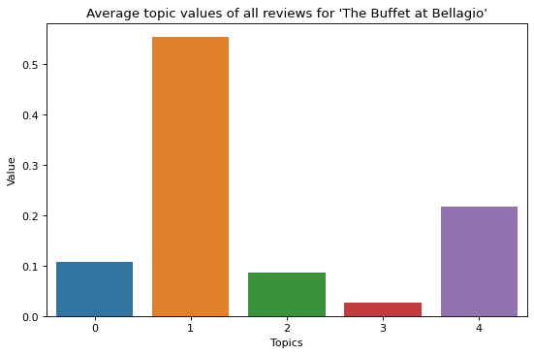
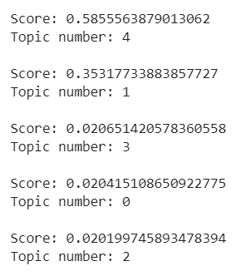
Topic Modelling - II
Poor Non -
Vegetarian Dishes
Example review from ‘The Buffet at Bellagio’ -
'really really disappointing nothing tasty several thing inedible definitely not worth money spent'
Average values
for all reviews

Slide 9
Latent Semantic Analysis
Top 3 topics
Positive Reviews |  |  |  |  |  | Negative Reviews
1 |  | 2 |  | 3 |  | 1 |  | 2 |  | 3
0.279 | food | 0.559 | great | -0.898 | pizza | 0.284 | food | 0.498 | room | 0.421 | pizza
0.257 | great | 0.256 | food | -0.152 | great | 0.213 | place | 0.33 | hotel | -0.36 | order
0.236 | place | 0.254 | order | -0.125 | crust | 0.181 | service | -0.255 | food | 0.29 | buffer
0.184 | service | -0.2 | pizza | 0.104 | food | 0.175 | order | 0.214 | stay | 0.254 | food
0.155 | order | 0.188 | service | 0.078 | sushi | 0.155 | great | -0.196 | order | 0.253 | great
Relative Strength

Slide 10
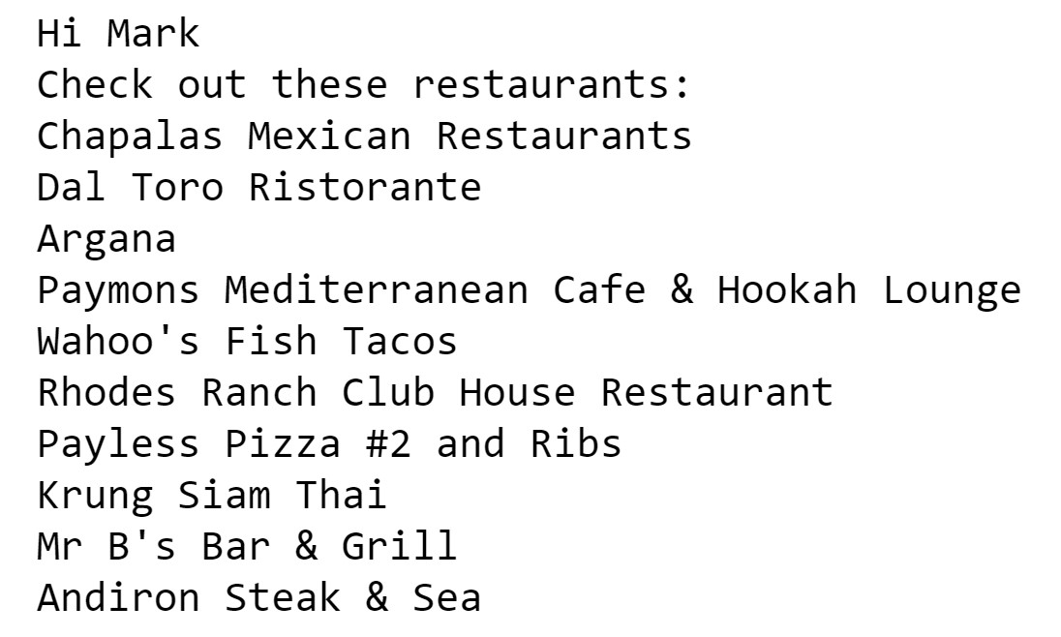
Collaborative filtering
Input Username
User similarity
Top 10 recommendations
Stars and Rating

Slide 11
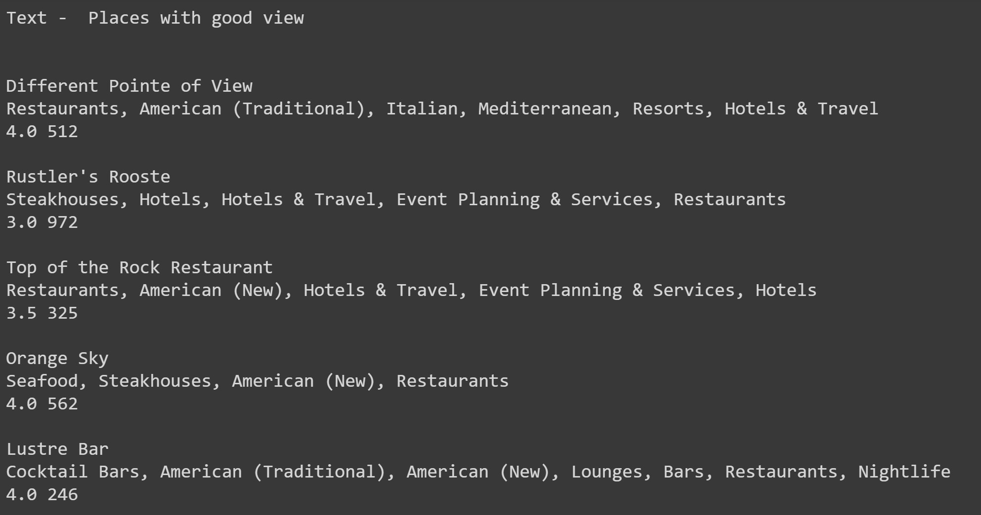
Text-Based Recommender System - I
Input text
Top restaurant recommendations

Slide 12
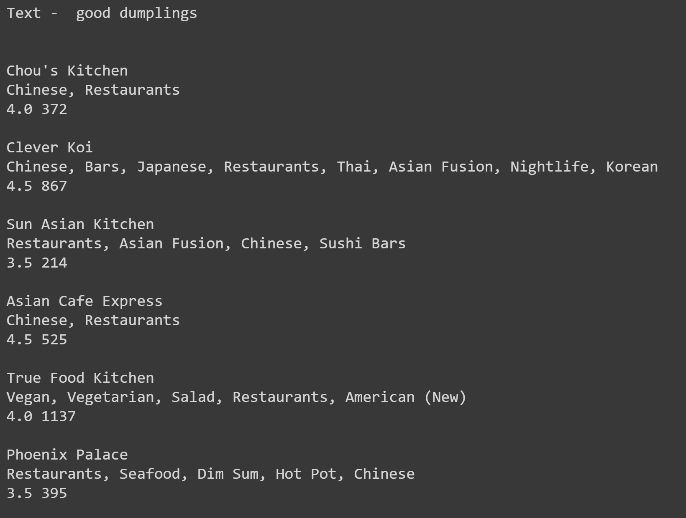
Text-Based Recommender System - II
Input text
Top restaurant recommendations

Slide 13
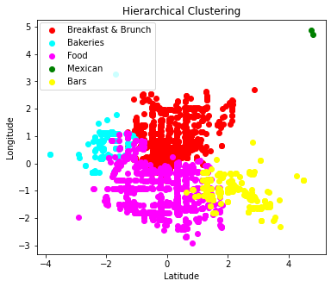
Excellently failed
Apriori Algorithm for finding Frequent patterns in the review:
Not very insightful results from the tips
Hierarchical clustering:
Not able to identify the predefined number of cluster
Labels at different location as compared to K-Means and GMM
Identified food as category

